Slide 1
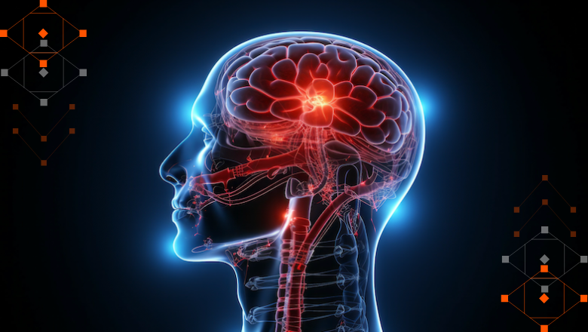
AI-Based Brain Tumour Detection
Using MRI Images and Deep Learning
Presented by: Jahnavi R

Slide 2
Problem Statement
To develop an AI-based brain tumour detection system using MobileNetV2 transfer learning that automatically analyzes MRI images and classifies them as “Tumour” or “No Tumour.”
Classify brain MRI images into Tumor and No Tumor using deep learning.
Academic prototype only — not a clinical diagnostic device.

Slide 3
Objectives
• Public dataset collection
• Image preprocessing
• Data augmentation
• Transfer learning
• Model evaluation
• Streamlit demonstration

Slide 4
Literature Review
• CNNs are widely used in medical image classification
• Transfer learning is useful with limited labeled data
• Recent reviews discuss CNNs, transfer learning, attention and transformers
• Challenges include dataset bias, class imbalance and clinical generalization

Slide 5
Research Gap
• Different datasets and validation protocols make comparisons difficult
• Public datasets may not represent clinical populations
• High validation accuracy does not prove clinical readiness

Slide 6
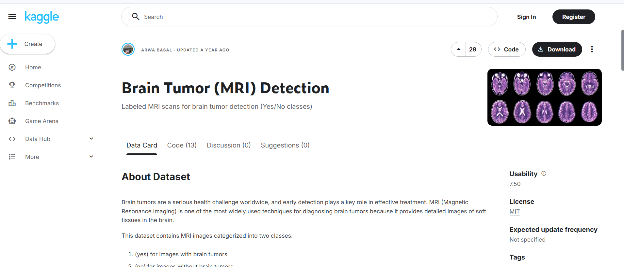
Dataset
Brain Tumor (MRI) Detection — Kaggle
Author: Arwa Basal
Classes: yes (Tumor), no (No Tumor)
https://www.kaggle.com/datasets/arwabasal/brain-tumor-mri-detection

Slide 7
Preprocessing
• Validate images
• RGB conversion
• Resize to 224 × 224
• 80:20 training-validation split
• Fixed random seed

Slide 8
Data Augmentation
Training-only:
• Horizontal flip
• Rotation
• Zoom
• Contrast
Purpose: improve robustness and reduce overfitting

Slide 9
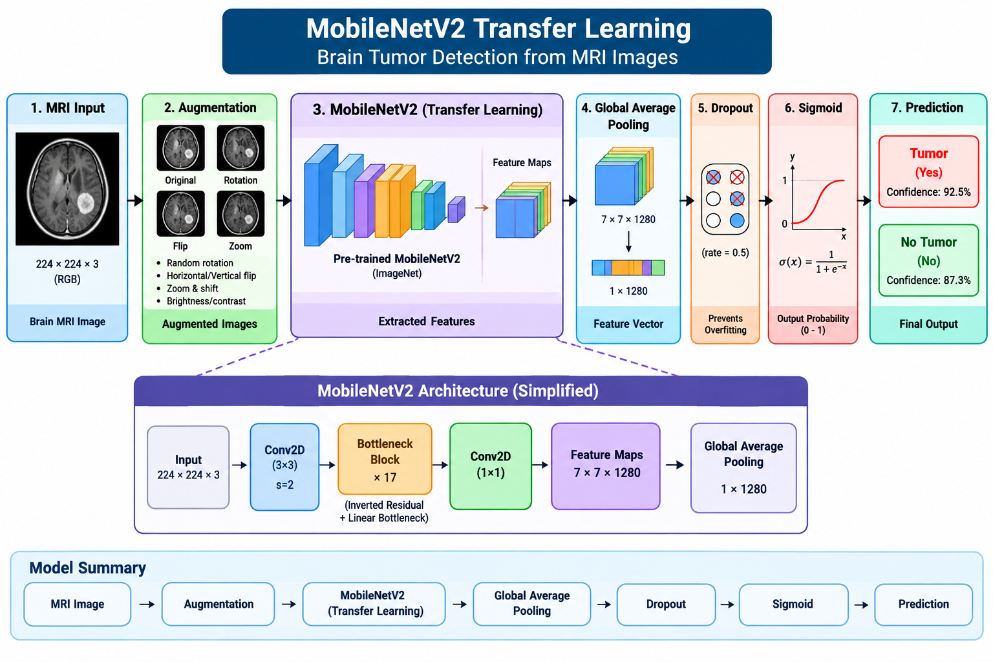
Model Architecture
MobileNetV2 Transfer Learning
MRI → Augmentation → MobileNetV2 → Global Average Pooling → Dropout → Sigmoid → Prediction

Slide 10
Training
• Binary cross-entropy
• Adam optimizer
• Frozen-backbone training
• Limited fine-tuning
• Early stopping
• Learning-rate reduction

Slide 11
Evaluation
Metrics:
• Accuracy
• Precision
• Recall
• F1-score
• Confusion matrix
Replace placeholders with actual values from metrics.json.

Slide 12
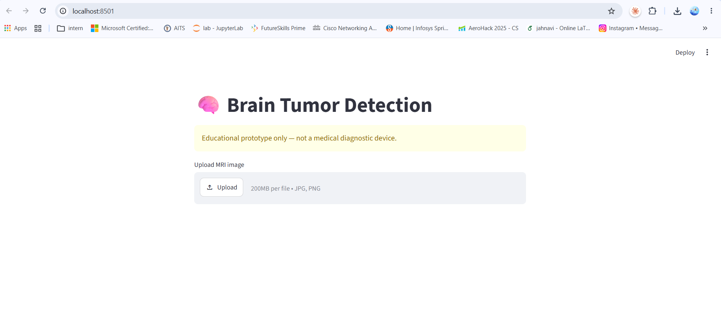
Streamlit Demo
1. Open Streamlit
2. Upload MRI
3. Click Analyze MRI
4. View Tumor / No Tumor
5. View model confidence
python -m streamlit run app.py

Slide 13
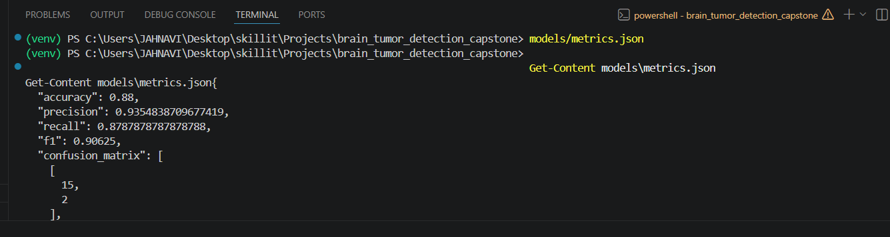
Results
Insert screenshots:
• Accuracy curve
• Loss curve
• Confusion matrix
• Streamlit result
Use only actual training results.

Slide 14
Limitations & Ethics
• Public dataset limitations
• Possible dataset bias
• No external clinical validation
• Not a diagnostic device
• Confidence ≠ clinical certainty

Slide 15
Conclusion & Future Scope
End-to-end MRI classification pipeline completed.
Future: external validation, Grad-CAM, other CNN architectures, cross-validation and larger datasets.

Slide 16
References
Kaggle dataset and systematic reviews on brain MRI deep learning and transfer learning.
Full references are in the project report.

